Slide 1
CS 4504 Parallel and Distributed Computation MapReduce
Kun Suo
Computer Science, Kennesaw State University
https://kevinsuo.github.io/

Slide 2
Outline
Single server vs multiple server processing
Divide-and-conquer
MapReduce
Map
Reduce
How it works
Fault-tolerance
Limitation

Slide 3
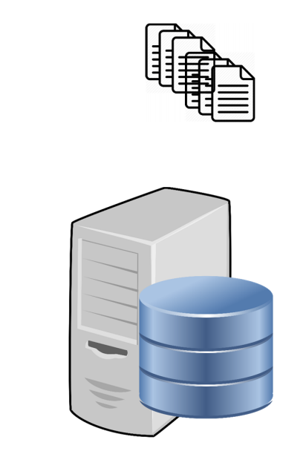
Processing Data on a single Machine
Data on file system on disk
Simple processing flow:
1. Read into memory
2. Process data (apply some function)
3. Write back to disk

Slide 4
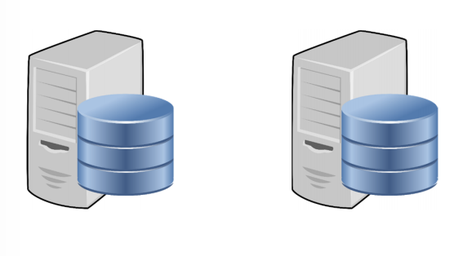
Why Multiple Servers?
Data size larger than disk capacity
Sequentially processing data can be slow
Limited by disk read/write speeds
Parallel processing can significantly reduce time
Single point of failure with a single server

Slide 5
Divide-and-Conquer
A divide-and-conquer algorithm works by recursively breaking down a problem into two or more sub-problems of the same or related type, until these become simple enough to be solved directly. The solutions to the sub-problems are then combined to give a solution to the original problem.

Slide 6
Divide-and-Conquer
How to get the total population of USA?

Slide 7
What kind of problem can Divide-and-Conquer solve?
Problem characteristics:
The scale of the problem is large or complex, and the problem can be broken down into several smaller, simple problems of the same type to solve
The sub-problems are independent of each other
The solutions of the sub-problems can be combined to obtain the solution of original problem

Slide 8
How to Use Divide-and-Conquer
Decompose the original problem.
The original problem is decomposed into several smaller, independent sub-problems that have the same form as the original problem.
Solve subproblems.
If the sub-problems are small and easy to solve, solve them directly;
Otherwise, solve the sub-problems recursively.
Merging solutions
Merge the solutions of the sub-problems into solutions of the original problem.

Slide 9
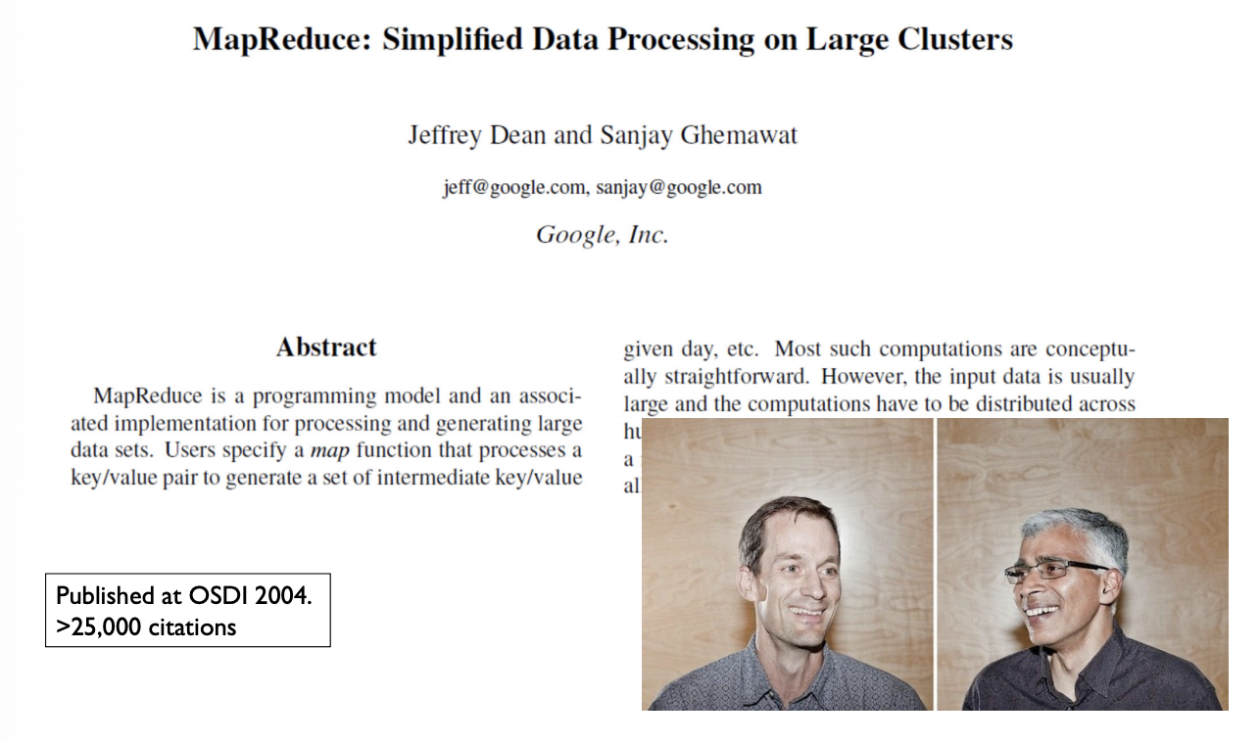
MapReduce
https://static.googleusercontent.com/media/research.google.com/en//archive/mapreduce-osdi04.pdf

Slide 10

Why MapReduce?
Automated parallelization and distribution of data and processing
Clean, powerful, well-understood abstraction (Map and Reduce)
Fault-tolerance
Scalability: 1000s of servers, TBs of data, …
Apache Hadoop: widely used open source Java implementation

Slide 11


MapReduce
MapReduce is divided into two core phases: Map and Reduce
Map corresponds to ”divide”: complex tasks are broken down into several simple tasks for execution
Reduce corresponds to ”conquer”: the results of the Map phase are summarized.
Large tasks
small tasks
Results

Slide 12
Map
The small tasks after map have the following characteristics:
Compared to the original task, the divided sub-tasks are homogeneous with the original task
The sub-task data size and calculation size is much smaller
There are no dependencies between different sub-tasks, which can run independently and run in parallel
Large tasks
small tasks
Results

Slide 13
Reduce
After the division of the sub-tasks in the first stage is completed, the calculation results of all sub-tasks are summarized to obtain the final results.
Large tasks
small tasks
Results

Slide 14
How the MapReduce works
MapReduce includes the three components:
Master (MRAppMaster): is responsible for assigning tasks, coordinating the operation of tasks, and assigning map function operations to Mappers, and reduce function operations to the Reducers.
Mapper worker: is responsible for Map function and performing sub-tasks.
Reducer worker: is responsible for Reduce function and summarizing the results of each sub-task

Slide 15
How the MapReduce works
Workflow (step 1):
User Program sends the task to MRAppMaster. Then, MRAppMaster splits the task into M subtasks (M is a user-defined value).
Example: Assume that the MapReduce function divides the task into 5, of which there are 3 Map jobs and 2 Reduce jobs.

Slide 16
How the MapReduce works
Workflow (step 2):
MRAppMaster assigns Map and Reduce jobs to Mapper and Reducer, respectively.
The number of Map jobs is the number of divided subtasks, which is 3; Reduce jobs are 2

Slide 17
How the MapReduce works
Workflow (step 3):
The Mapper worker starts reading the input data of the subtask and extracts the <key, value> pairs from the input data.
Each key-value pair is passed to the map () function as a parameter.

Slide 18
How the MapReduce works
Workflow (step 4):
The output of the map () function is stored in the ring buffer <k, v>Buffer.
These results are periodically written to the local disk and stored in R different disk areas. Here R represents the number of Reduce jobs. In this case, R = 2. Also, the storage location of each Map result is reported to the MRAppMaster.

Slide 19
How the MapReduce works
Workflow (step 5):
The MRAppMaster informs the Reducer which partition it is responsible for, and the Reducer remotely reads the corresponding Map result, which is the intermediate key-value pair.
After the Reducers read all the intermediate key-value pairs it is responsible for, it sorts and aggregates the key-value pairs of the same key value.

Slide 20
How the MapReduce works
Workflow (step 6):
The reducer traverses the sorted key-value pairs, merges the key-value pairs with the same key value, and stores the statistical results as output files in the corresponding partition.

Slide 21

How the MapReduce works
The entire workflow of MapReduce can be divided into 5 parts:
Input, splitting, mapping, reducing and final result

Slide 22
Fault-Tolerance in MapReduce
Master fails
Switch to secondary master
Restart entire job
Worker fails
If running map: restart map tasks on available/free worker nodes
If running reduce: restart reducer tasks

Slide 23



MapReduce Example
We want to know the top 3 selling smartphones in Alabama, Georgia and Florida area
AL | GA | FL
LG | Sumsang | LG
Sumsang | apple | apple
apple | LG | Sumsang
… | … | …

Slide 24
MapReduce Example
Splitting: divide the task into 3 sub-tasks
AL
LG
sumsang
…
AL | GA | FL
LG | Sumsang | LG
Sumsang | apple | apple
apple | LG | Sumsang
… | … | …
GA
sumsang
apple
…
FL
LG
apple
…

Slide 25
MapReduce Example
Mapping: keep calling map() function and get the selling statistics of each smartphone brand. Here the key is the smartphone brand and value is the number
AL
LG
sumsang
…
AL
<LG, 1>
<sumsang, 1>
…
AL
<LG, 20>
<sumsang, 10>
<apple, 5>
GA
sumsang
apple
…
GA
<sumsang, 1>
<apple, 1>
…
GA
<sumsang, 30>
<apple, 15>
<LG, 10>
FL
LG
apple
…
FL
<LG, 1>
<apple, 1>
…
FL
<LG, 40>
<apple, 30>
<sumsang, 20>

Slide 26
MapReduce Example
Shuffuling: read the results of the Mapping phase and divide the different results into different areas
LG, 20
LG, 10
LG, 40
AL
<LG, 1>
<sumsang, 1>
…
AL
<LG, 20>
<sumsang, 10>
<apple, 5>
Apple, 5
Apple, 15
Apple 30
GA
<sumsang, 1>
<apple, 1>
…
GA
<sumsang, 30>
<apple, 15>
<LG, 10>
sumsang, 10
sumsang, 30
sumsang, 20
Oppo, 10
Oppo, 15
FL
<LG, 1>
<apple, 1>
…
FL
<LG, 40>
<apple, 30>
<sumsang, 20>
Moto, 5
Moto, 3

Slide 27
MapReduce Example
Reducing: merge the results of the same brand
LG, 20
LG, 10
LG, 40
LG, 70
AL
<LG, 1>
<sumsang, 1>
…
AL
<LG, 20>
<sumsang, 10>
<apple, 5>
Apple, 5
Apple, 15
Apple 30
Apple, 50
GA
<sumsang, 1>
<apple, 1>
…
GA
<sumsang, 30>
<apple, 15>
<LG, 10>
sumsang, 10
sumsang, 30
sumsang, 20
sumsang, 60
Oppo, 10
Oppo, 15
Oppo, 25
FL
<LG, 1>
<apple, 1>
…
FL
<LG, 40>
<apple, 30>
<sumsang, 20>
Moto, 5
Moto, 3
Moto, 8

Slide 28
MapReduce Example
Final results: get the top 3 selling smartphones in Alabama, Georgia and Florida area
LG, 20
LG, 10
LG, 40
LG, 70
AL
<LG, 1>
<sumsang, 1>
…
AL
<LG, 20>
<sumsang, 10>
<apple, 5>
Apple, 5
Apple, 15
Apple 30
Apple, 50
GA
<sumsang, 1>
<apple, 1>
…
GA
<sumsang, 30>
<apple, 15>
<LG, 10>
sumsang, 10
sumsang, 30
sumsang, 20
sumsang, 60
LG, 70
Sumsang, 60
Apple, 50
Oppo, 10
Oppo, 15
Oppo, 25
FL
<LG, 1>
<apple, 1>
…
FL
<LG, 40>
<apple, 30>
<sumsang, 20>
Moto, 5
Moto, 3
Moto, 8

Slide 29
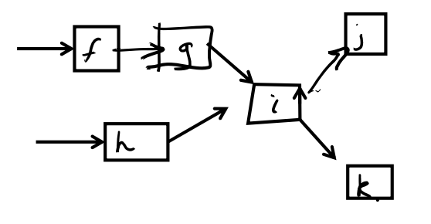
MapReduce Limitations
Static data
Restrictive programming model
No support for dataflows (not dynamic)
Purely batch processing (not flow)
Jobs can take hours to complete
No streaming, interactive analytics
How many mappers and reducers?
How much memory to allocate?

Slide 30
When NOT To Use MapReduce
Modern computing hardware has plenty of computing power:
A typical laptop: 8 cores, 16 GB RAM, 512 GB SSD (usually NVMe)
A typical server: 64 cores, 256 GB RAM, 2 TB SSD, …
Is your dataset really that large?
Wikipedia: 30 GB
In many cases, an optimized non-distributed implementation beats a large cluster (!)

Slide 31
Conclusion
Single server vs multiple server processing
Divide-and-conquer
MapReduce
Map
Reduce
How it works
Fault-tolerance
Limitation

